Slide 1
Quantitative Trading and Algorithms
By Hrant Virabyan

Slide 2
01
What is Quantitative Trading?

Slide 3
What is quantitative trading?
Buying and selling of assets
Mathematical models in all steps of the process (creating, functioning, executing, etc.)
Mathematical models are coded into code in order to execute

Slide 4
Steps to Quantitative Trading
1.
2.
3.
4.
Translate hypothesis into a concrete mathematical model
Translate the mathematical model into executable code
Evaluate the strategy and scan for any flaws (Review and simulations)
Execute the program on live market to earn money.

Slide 5


Hypothesis
Historical Data
Moving Average Crossovers
Statistics and applied mathematics
Quants use these in order to come up with a hypothetical model to build upon

Slide 6

2. Coding
Quant Algorithm Engineers create code
Code is used to trade the assets
Run simulations
The same code in the simulation must be used live, line by line - no changes

Slide 7

3. Evaluation
Review and compute the properties of the strategy
P&L Percent
Stop-loss
Holding time distribution
Maximal drawdown

Slide 8
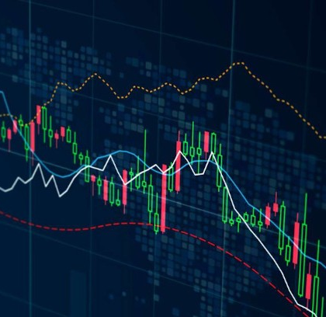
4. Trading
Put in the capital incrementally
Install safety measures
Monitor and review
Market change

Slide 9
What does this mean?

Slide 10
Current Tech and Algorithms
Complex mathematical models
Mean reversion strategies
AI-driven models
Active Limitations

Slide 11
Quantum Computing
Notes:
4

Slide 12
Algorithms with Quantum Computing
Transformative potential
Enhanced speed
Complex calculations
Effective risk management
Simultaneous simulations
Significant edge
Notes:
5

Slide 13
Popular Quantum Algorithms
01
02
03
04
Amplitude Estimation
Monte Carlo
Quantum Annealing
Fourier Transform
Provides quadratic speed-up over classical methods.
Enhances simulations for pricing derivatives and assessing risk.
Optimization problems in trading, such as portfolio optimization/risk management
Crucial for signal processing in trading algorithms
Notes:
Para

Slide 14

Potential New Strategies
Quantum computing is poised to revolutionize algorithmic trading by enabling real-time multivariable optimization and extensive scenario simulations, allowing traders to better predict market volatility and analyze numerous variables simultaneously.
Notes:
6

Slide 15

Thank you!

